Slide 1
BOUNDARY VALUE ANALYSIS
Test case:
The car speed should be in between 50 km/hr- 90 km/hr, and if the speed is lower than 50 and higher than 90, then our software should send the notification.
To test software, we will pick boundary values like 50,51,89,90. We will check our software performance on these boundary values.
If the values are entered below 50 and above 90 then it will be considered invalid case.
If the value entered is between 50-90 then it will be a valid case.
Invalid Test Case (Min Value-1) | Valid Test Case (Min,+Min,Max,-Max) | Invalid Test Case (Max Value+1)
49 | 50,51,89,90 | 91

Slide 2
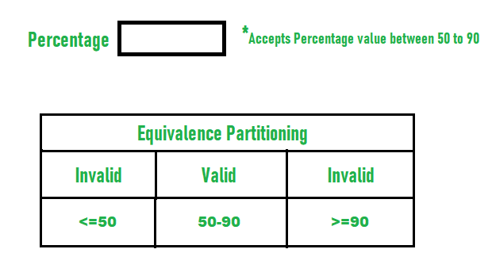
ECP:Equivalence Partitioning Method
College admission process based upon student’s percentage:
Consider percentage field that will accept percentage only between 50 to 90 %, more and even less than not be accepted, and application will redirect user to an error page.
If percentage entered by user is less than 50 %or more than 90 %, that equivalence partitioning method will show an invalid percentage.
If percentage entered is between 50 to 90 %, then equivalence partitioning method will show valid percentage.

